Slide 1
Employee Skill Management
IST 659 – Data base management Systems
Ankita Dhawan
April 18, 2016

Slide 2
Project Goals
Major functions of database systems are :
What data to collect
Employee details are collected
Project details which are assigned to employee
Trainings details for which employees have acquired
Skills on which employees are getting trained
Client details for each project

Slide 3
Project Goals
Who can Input the data
Supervisor
Manager
Administrative staff
Who can query the data
Supervisor
Manager
Training teams
Employees

Slide 4
Project Goals
What are the major data questions
Find training status , enrolled date ,employee details based on the skill name?
How many number of projects department has and total expenditure spend by the department on those projects?
What is the total time spend on each project by each department?
How many trainings are enrolled by each employee in the organization?
Find the clients for which employees are working on specific projects

Slide 5
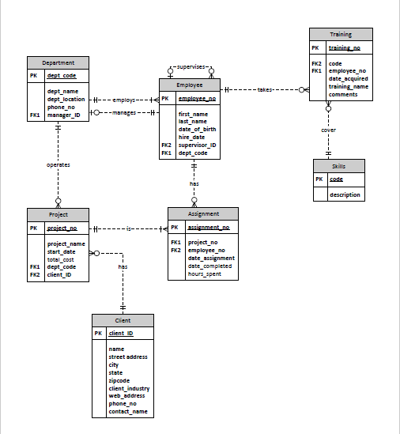
ER Diagram - Visio

Slide 6
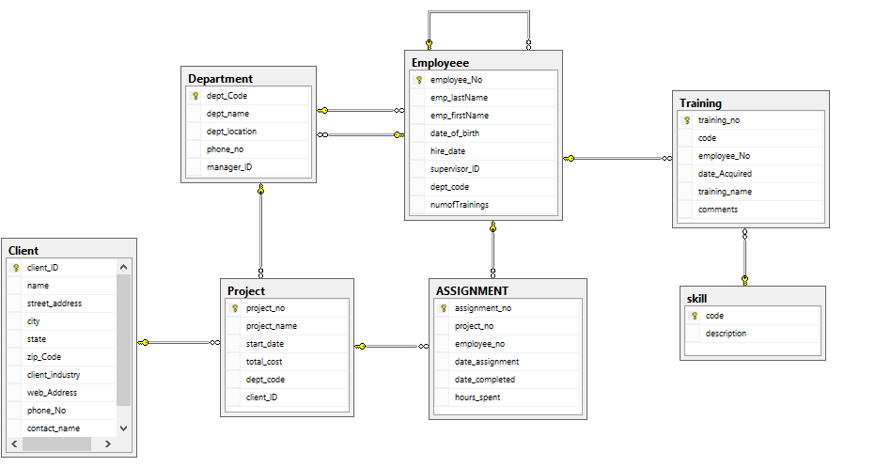
ER Diagram - SQL

Slide 7
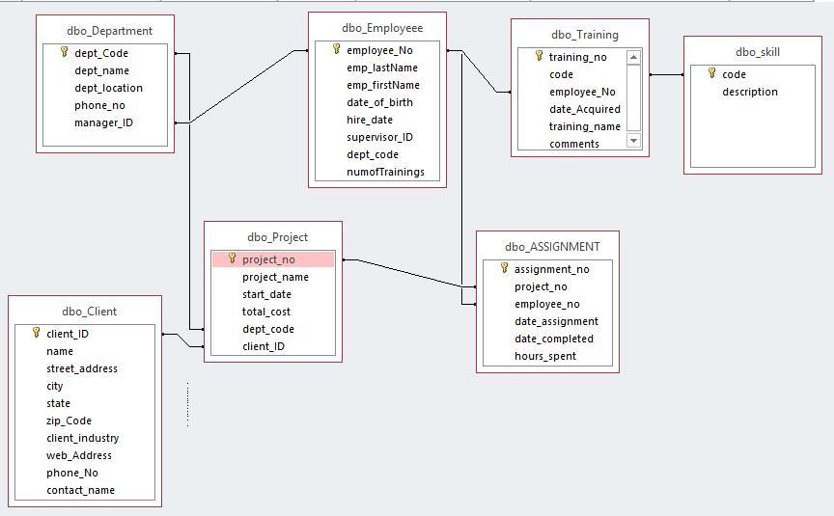
ER Diagram – Access Relationship Diagram

Slide 8
Forms
Total Number of Tables : 7
Total Number of Forms : 11
Number of Forms that you created so far : 11
User Login Form (Y) (user logs in to the system)
Department_form (Y)(allows you to add and view department records)
dbo_client (Y) (allows you to add and view client details)
Employee Training Details(Y)(allows you to view skill based training details for each employee)
Employee_form (Y)(allows you to add and view employee records)
Project Assignment_form(Y)(allows you to add record for project assigned to employee)
Project Information (Y) (allows you to add project details)
Training_status_form(Y) (allows you to retrieve training details for employee based on skill selected)
Skill Set details_form (Y) (allows you to add skill sets and view it)
Training details (Y) (allows you to add and view skill training details)
Employee Project Assignment (Y)(allows you to retrieve data to find which employees are assigned which project

Slide 9

Forms

Slide 10
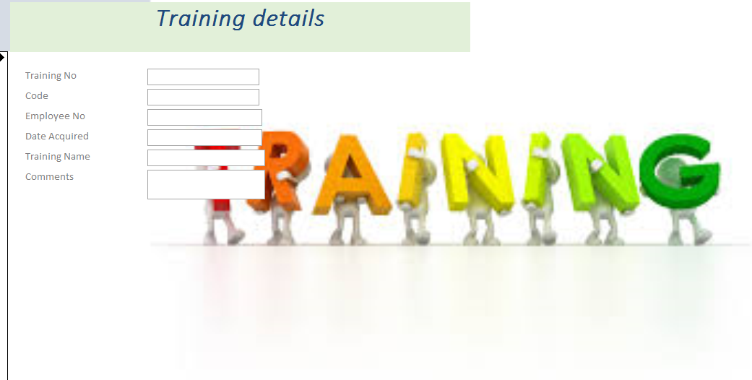
Forms
On Click , Select Skill, Training details for skill is retrieved

Slide 11
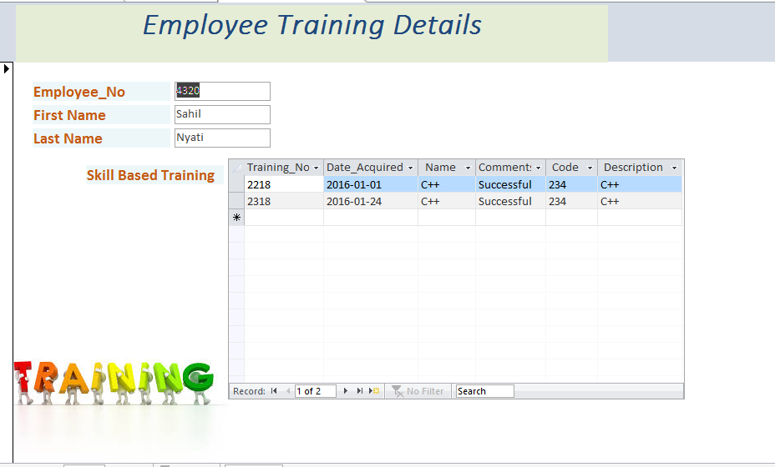
Forms
Training and skill acquired details for each employee

Slide 12
Major Data Questions- Reports
How many number of projects department has and total expenditure spend by the department on those projects (Y)
What is the total time spend on each project by each department (Y)
How many trainings are enrolled by each employee in the organization (Y)
Find the clients for which employees are working on specific projects(N)
Find training status , enrolled date ,employee details based on the skill name? (Form is created and data is retrieved) Report- (N)

Slide 13
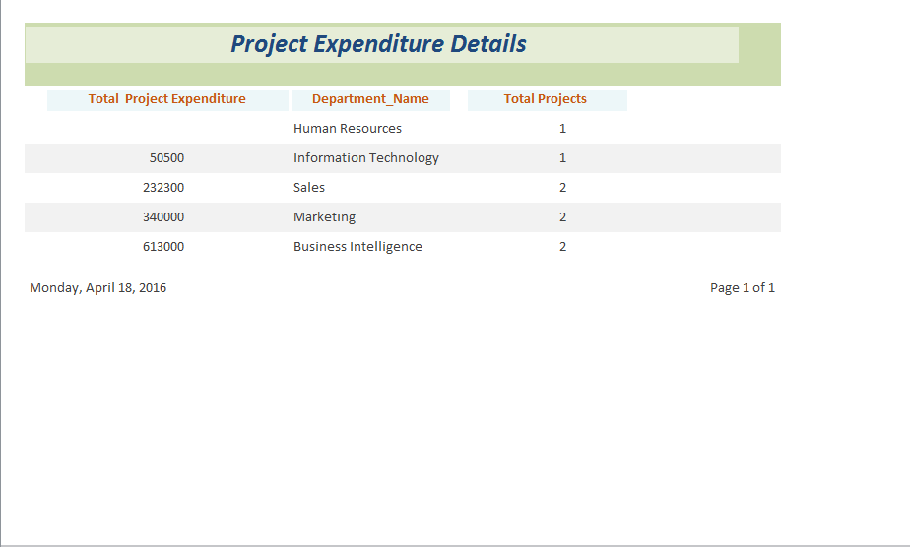
Report 1
How many number of projects department has and total expenditure spend by the department on those projects

Slide 14
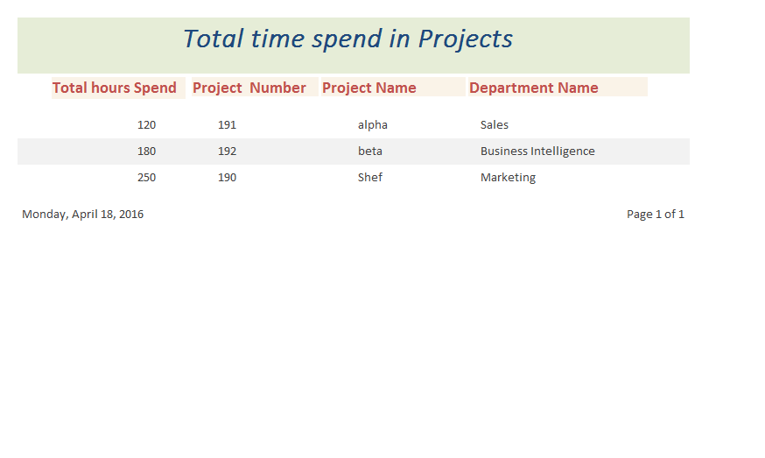
Report 2
What is the total time spend on each project by each department

Slide 15
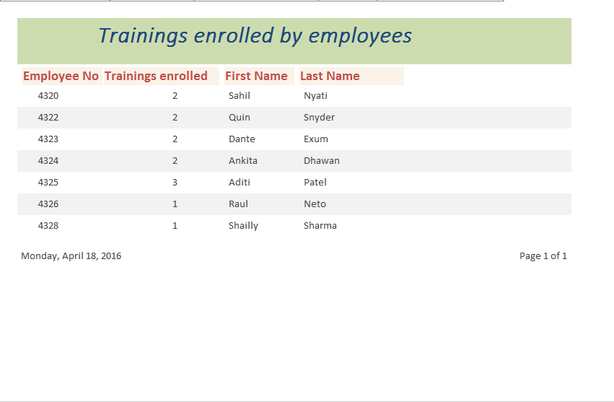
Report 3
How many trainings are enrolled by each employee in the organization

Slide 16
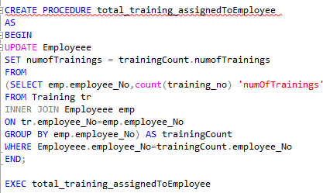
Procedure
This procedure count total trainings enrolled for employee

Slide 17
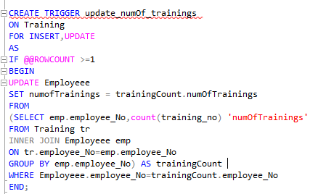
Trigger
This trigger updates the number of trainings when an employee enrolls in new training

Slide 18
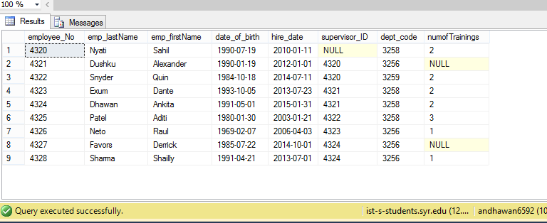
Trigger
Employee table with number of trainings before data is updated
SELECT * FROM Employeee;

Slide 19
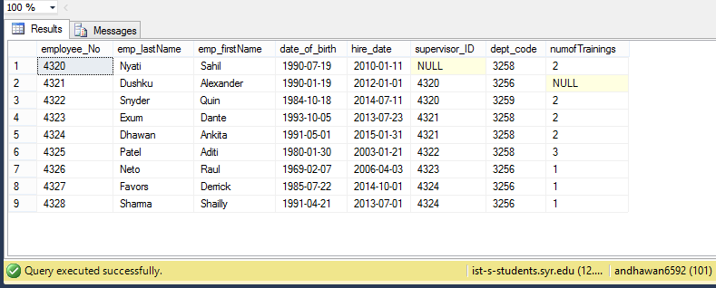
Trigger
Employee table with number of trainings after data is updated
INSERT INTO Training VALUES('2500','233','4327','2015-12-22','Python','Successful');

